Slide 1



GHG Emissions
Global Green House Emissions

Slide 2








MEET OUR TEAM
Smog Squad
Roaa
Ahmad
Habiba Hany
Menna
Ashraf
Mohab
Alaa
Ziad
Ibrahiem
Mazen
Hany

Slide 3

AGENDA
problem Statement
Objectives
Data Set Overview
Steps & Dashboards
Key Insights
Recommendations

Slide 4
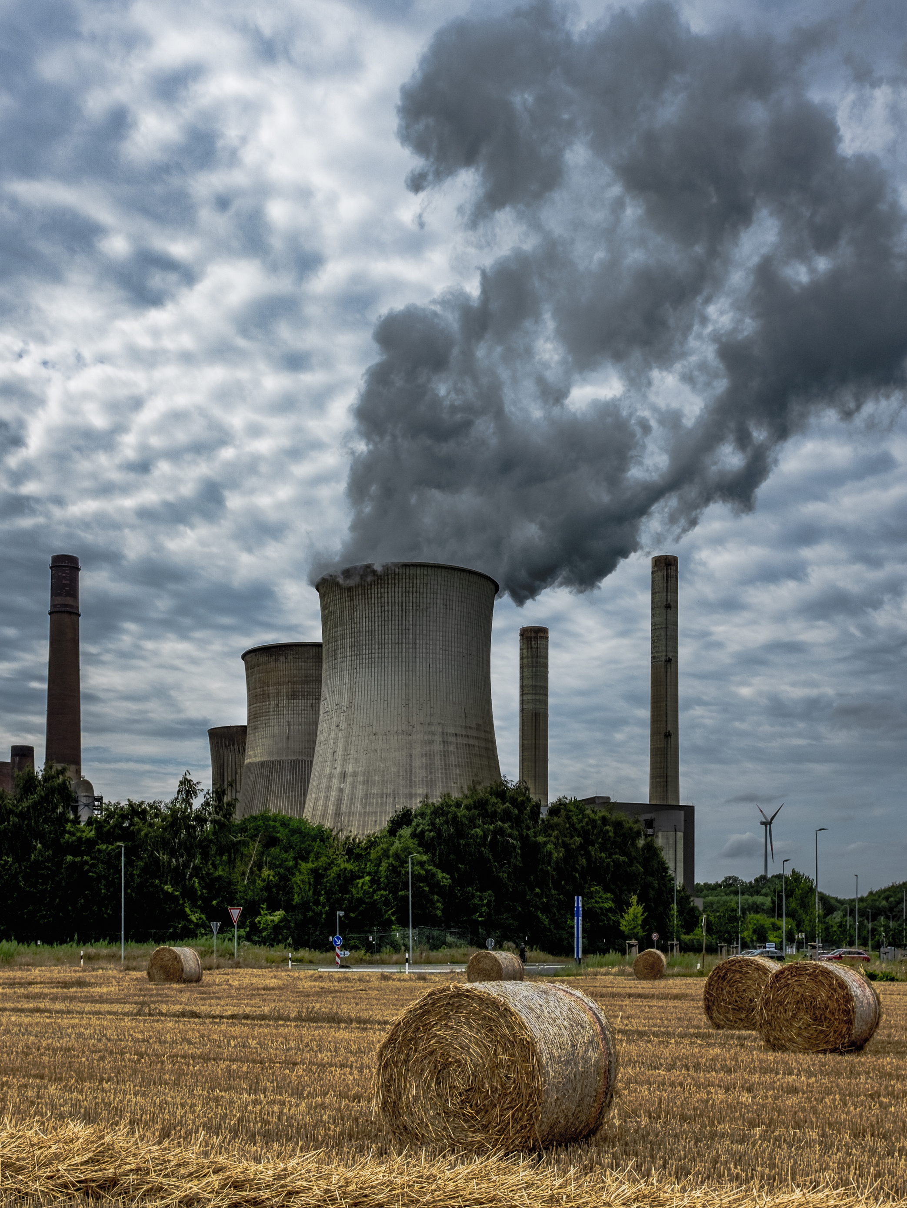
01
PROBLEM STATEMENT
Recent studies show an accelerating effect of climate change worldwid
Reports estimate an economic cost of up to 38 trillion USD by 2049, with approximately 7.9 million deaths per year worldwide (1 in 8 deaths).
Since emissions are the primary driver of this phenomenon, we aim to analyze global emissions data to identify the key causes and factors, and suggest potential solutions to address the issue.

Slide 5
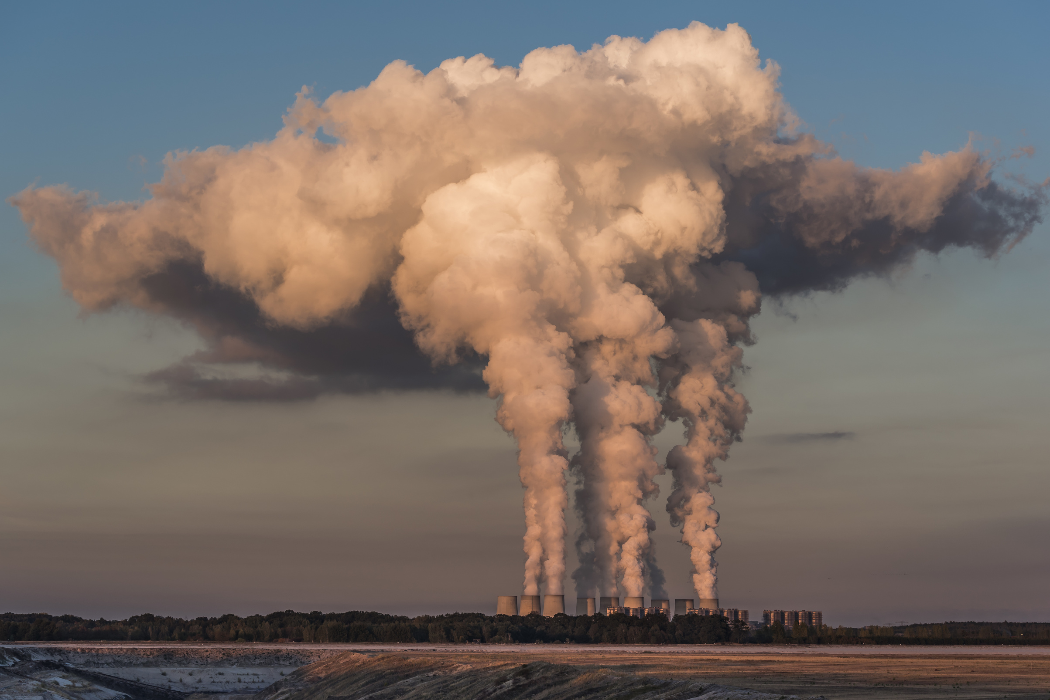

02
KEY OBJECTIVES
What is the total amount of emissions from 1990 to 2024?
What is the ranking of greenhouse gases based on their emission levels?
How have emissions changed over the period 1990–2024?
Which sectors contribute the most to emissions?
What are the top emitting countries?
Which countries have high carbon absorption or good vegetation cover?
How are the regions ranked in
terms of their emissions?
Which countries have a small population but high per capita emissions?
How are the income groups ranked in terms of their emissions?
Which countries have successfully reduced their carbon emissions during 2022–2024?

Slide 6
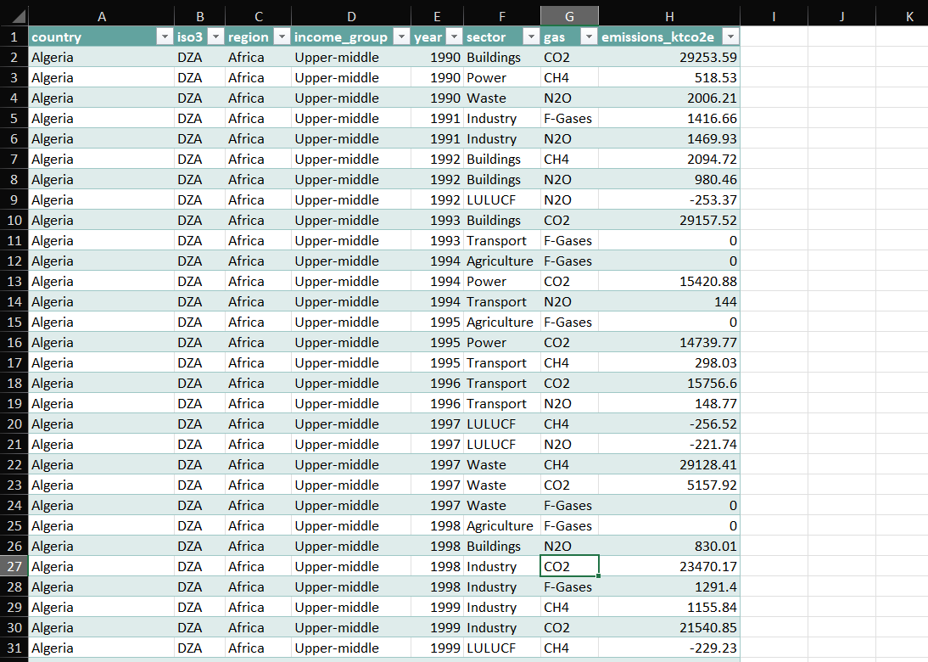
03
DATASET OVERVIEW
It includes data for countries with annual emission records from 1990 to 2024
The dataset covers different greenhouse gases (GHG).
Provides emission levels/values for each year.
Includes each country’s income group.
Contains information about sectors contributing to emissions.

Slide 7
STEPS

Slide 8
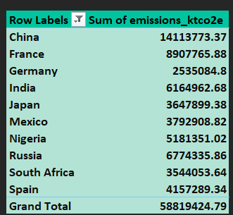
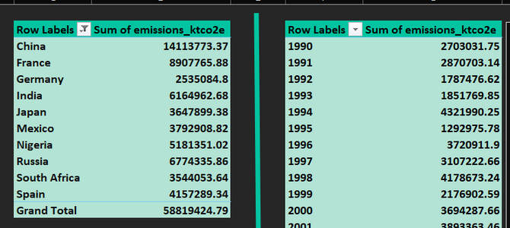

04
STEPS(EXCEL)
In Excel, we used Power Query to clean and prepare the dataset, then explored the data to extract as many insights as possible. We also used Pivot Tables for deeper analysis, and finally created an interactive dashboard to present our key findings.
Pivot Tables

Slide 9
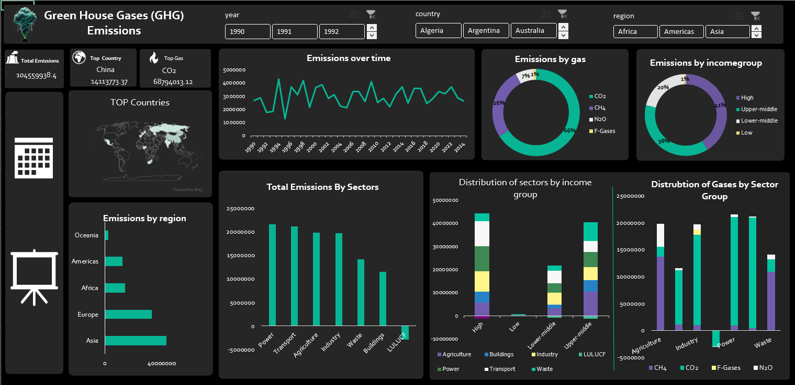
EXCEL DASHBOARD
In Excel, we created an interactive dashboard with slicers that allow filtering by year, sector, and region.

Slide 10
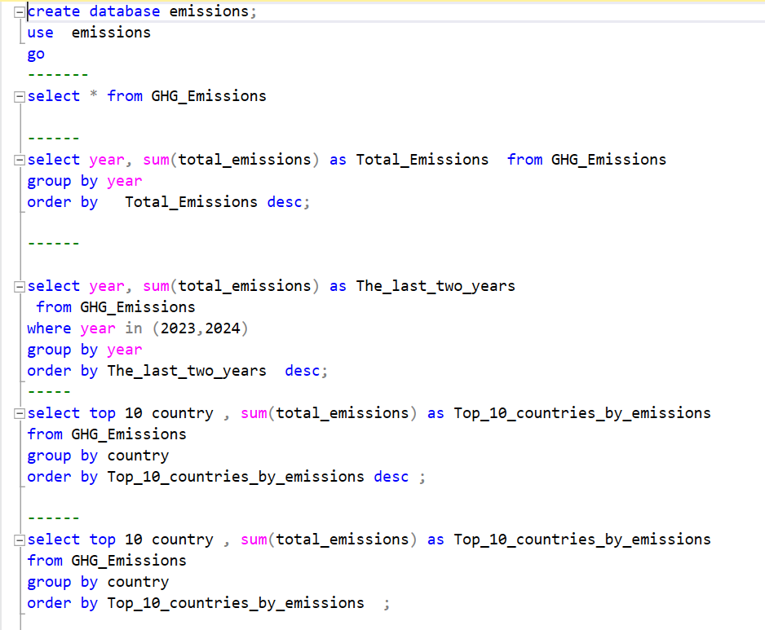
04 STEPS (SQL)
In SQL, we explored the dataset further by using queries that included SELECT, SUM, GROUP BY, and ORDER BY to better understand the data and extract meaningful insights.

Slide 11

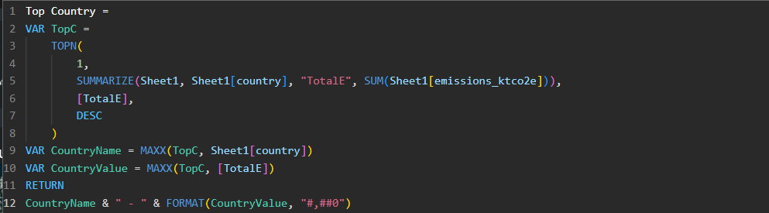
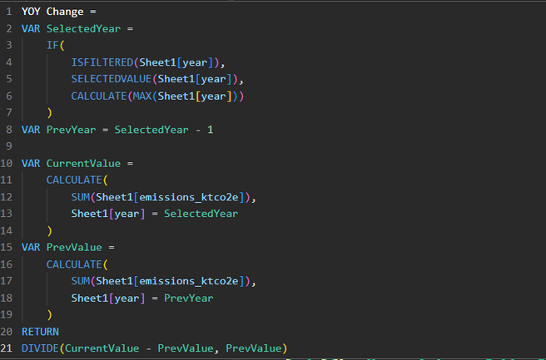
04
STEPS (POWER BI)
Page 03
We worked on Power BI to analyze our data and create an interactive report
Built a main report with a control page to navigate between different views and dashboards.
Explored the data to uncover important KPIs and patterns.
Created charts and tables to represent the data clearly.
Used DAX to create advanced measures such as Top N, IF statements, and other calculated fields to extract meaningful insights.

Slide 12
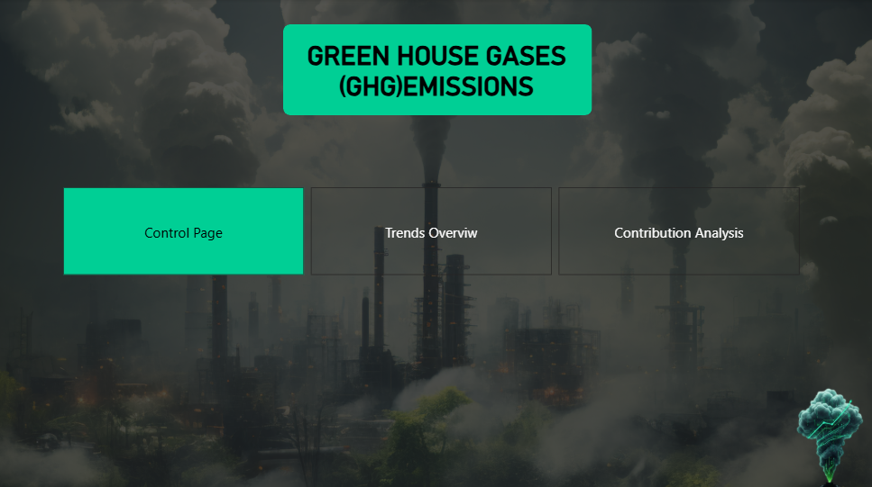
POWER BI DASHBOARD
Report

Slide 13
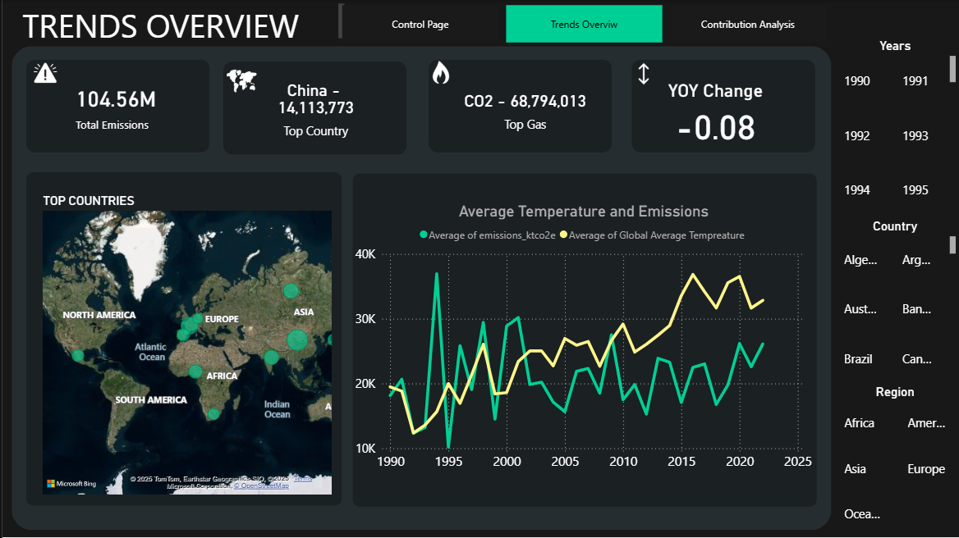
POWER BI DASHBOARD
Report

Slide 14
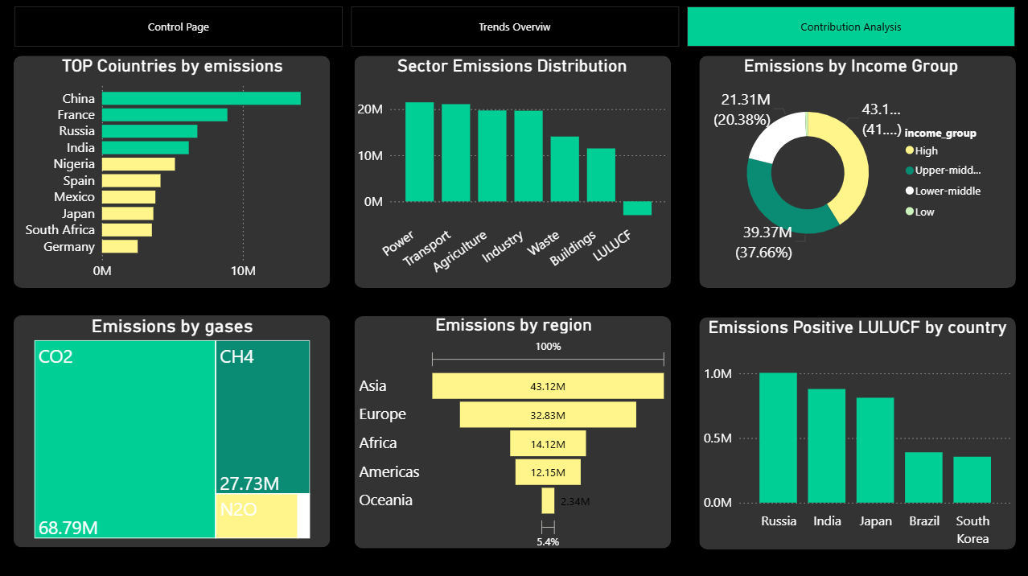
POWER BI
Report

Slide 15
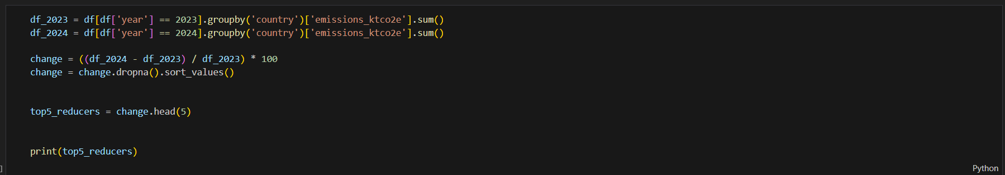
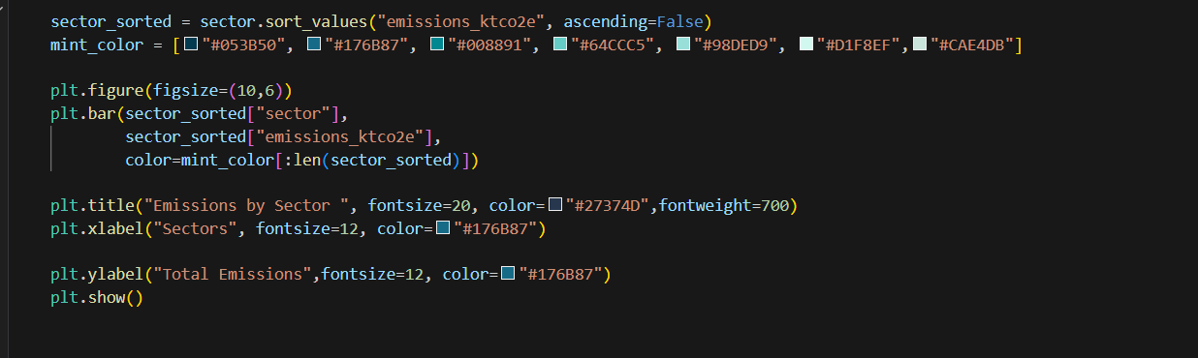

04
STEPS (PYTHON)
We used Python to check and clean the data using the Pandas library, which helped us discover deeper relationships and extract more advanced insights, and we also used Matplotlib and Seaborn to create clear visualizations that improved our understanding of the data."

Slide 16
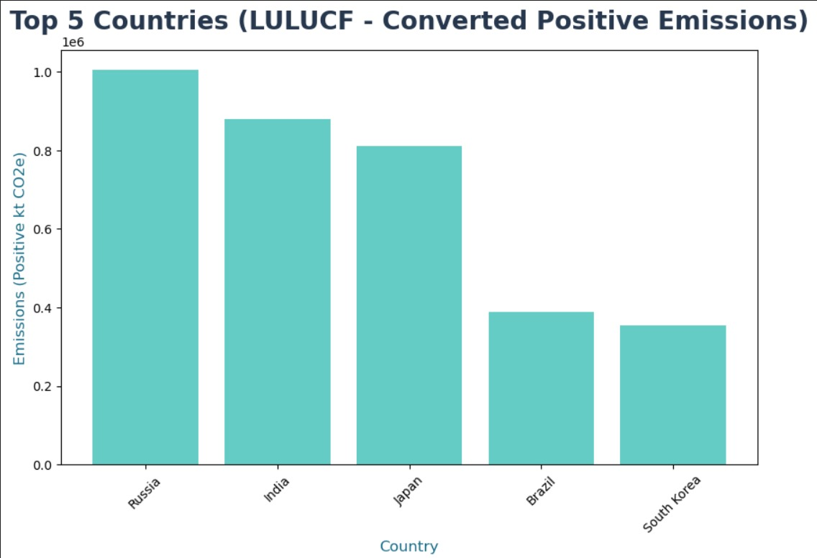
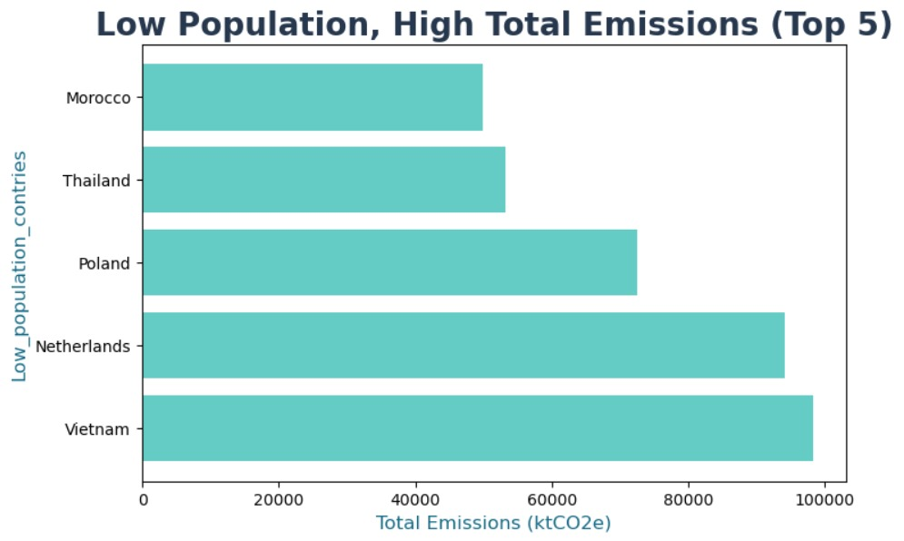
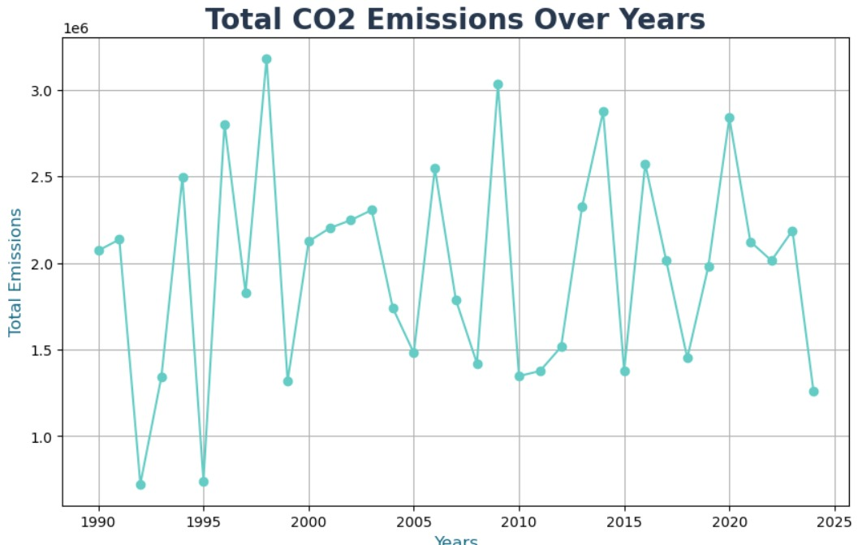
04
STEPS (PYTHON)
SAMPLE CHARTS (PYTHON)

Slide 17
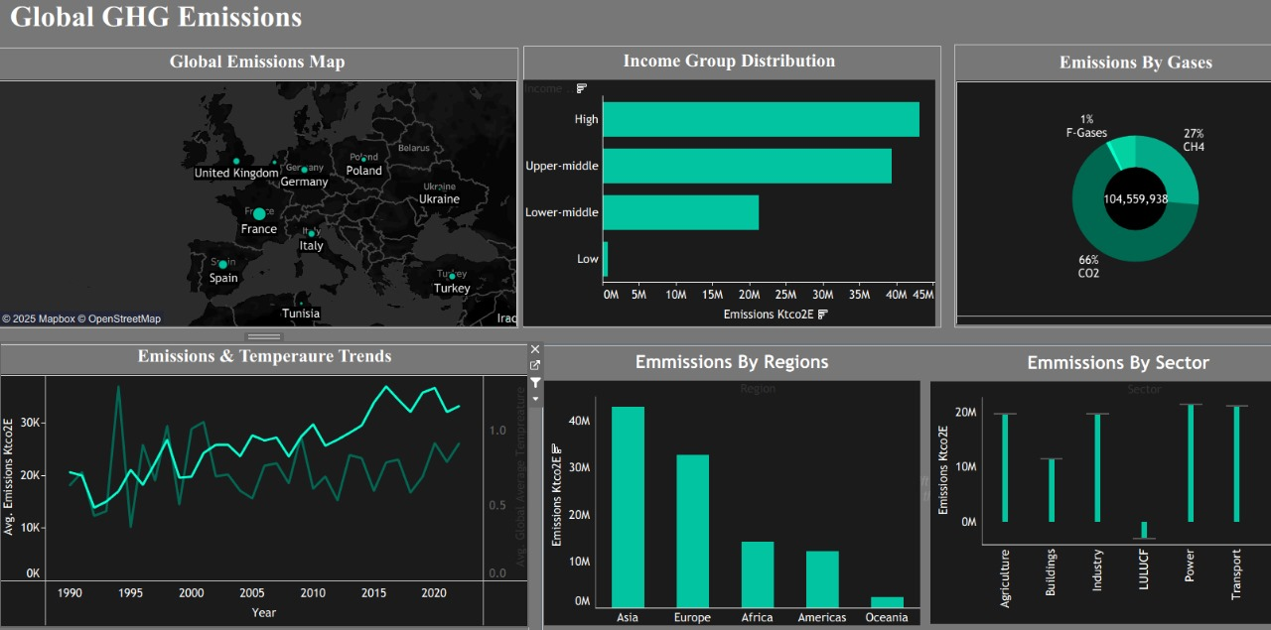
TABLEAU
DASHBOARD

Slide 18
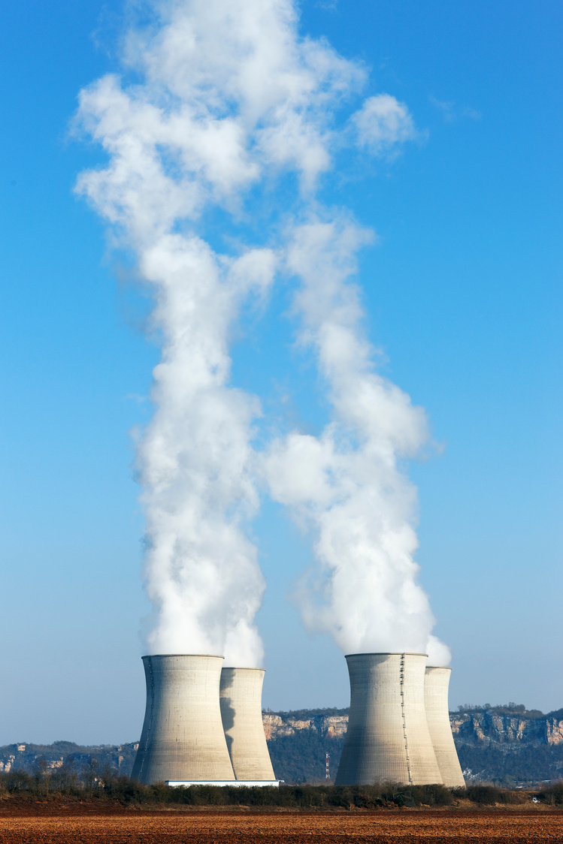

05
KEY INSIGHTS
Our group's total emissions reached 104 Million Tons between 1990 and 2023
Top National Emitters: China, France, Russia, and India are the leading contributors, confirming emissions are highly concentrated geographically.
Energy and Transport are the highest-contributing sectors globally
Carbon Dioxide CO2 is the primary driver, accounting for over 50% of total emissions, followed by other greenhouse gases.
Economic Driver: The Upper-Middle Income Group exhibits the highest emission rates

Slide 19
Prioritize agricultural emission reduction in China
Focus on long-term strategies instead of temporary measures to ensure continuous emission reduction.
Encourage countries like China, France, Russia, and India to reduce emissions, as this will significantly impact global levels.
RECOMMENDATIONS
Address individual behavior in high per capita emission countries
Enhance vegetation efficiency in Russia and India
Study emission reduction strategies in countries like Canada and the Philippines and adapt suitable practices locally.

Slide 20

Giggling Platypus Co.
THANKS FOR YOUR TIME
Smog Squad Team

